Slide 1
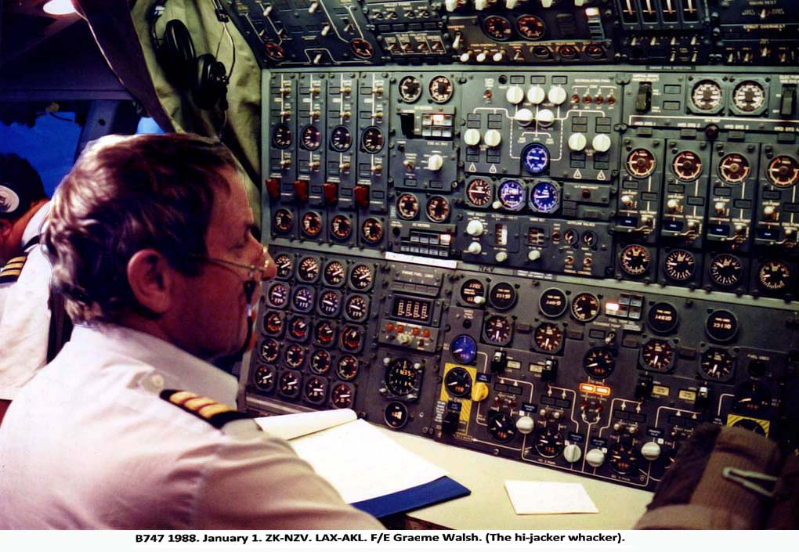
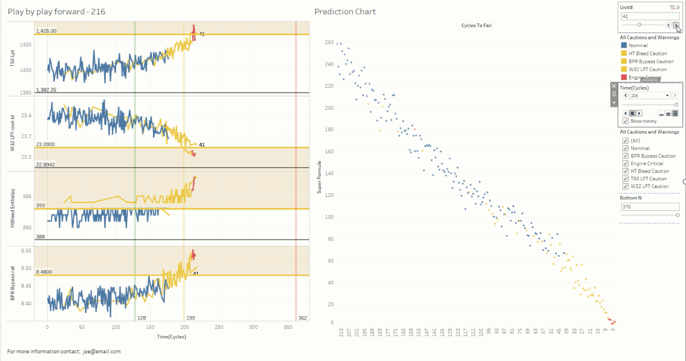
Flight Engineer
Aircraft Engine Anomaly and Fault Detection
Steven Fischbach
…the ‘Operational’ Data Scientist

Slide 2
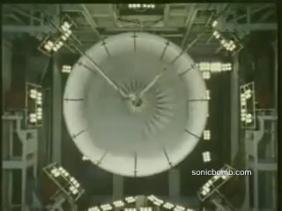
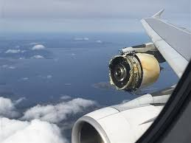
Planning to Avoid Failure
Failure is expensive!
Preventative maintenance
Scheduling timelines
Budget estimates

Slide 3

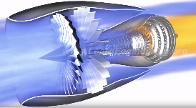



The Business

Slide 4
Data
NASA Dataset
Aircraft engine simulator
26 features
Randomized start
Operated until failure
15 measurements recorded once during a cycle

Slide 5
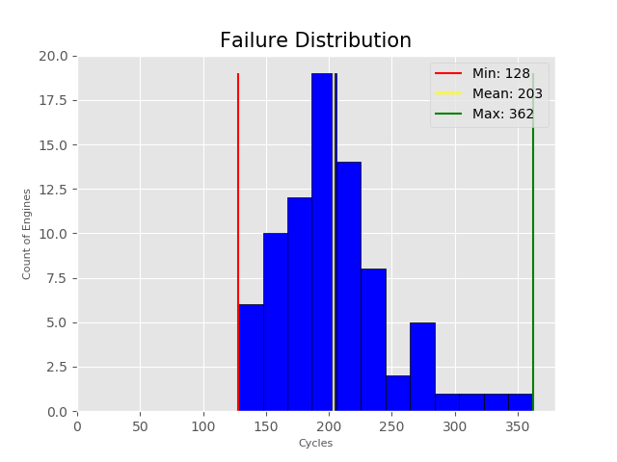
Once Per Cycle?
Cycle is one use of the engine
Cycle = startup + take-off + landing + shutdown
Time between startup and shutdown will vary

Slide 6
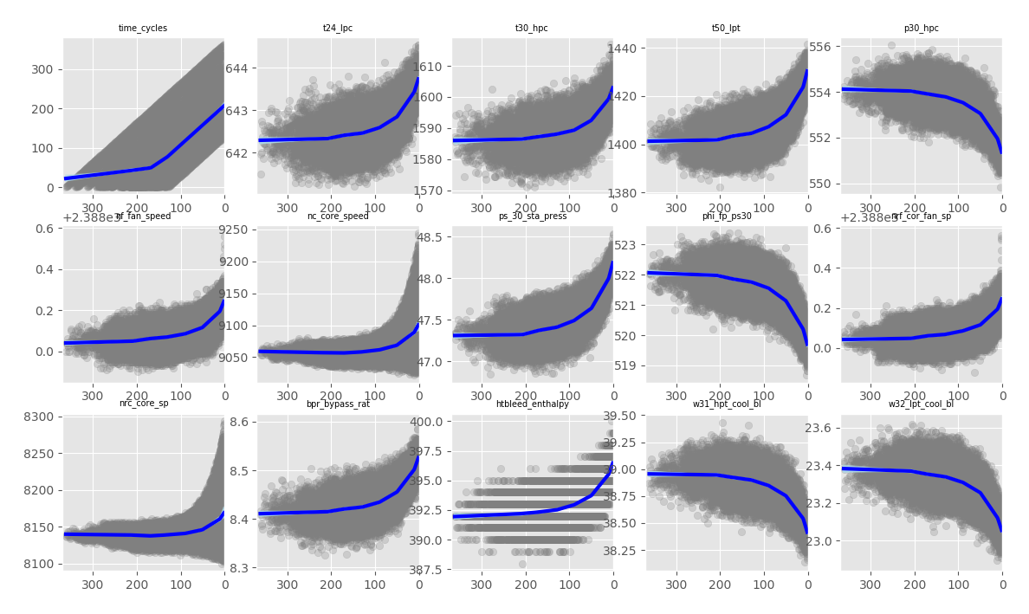
Predictive Features
Zero

Slide 7
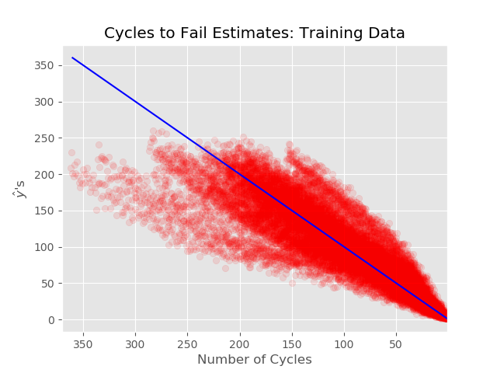
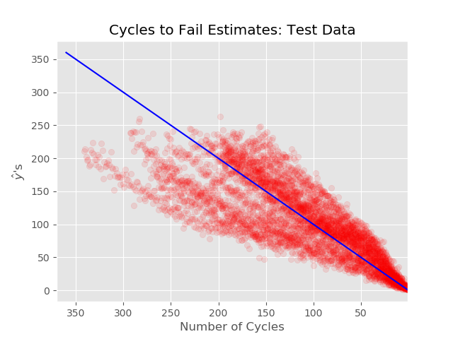
Results using knots and splines

Slide 8
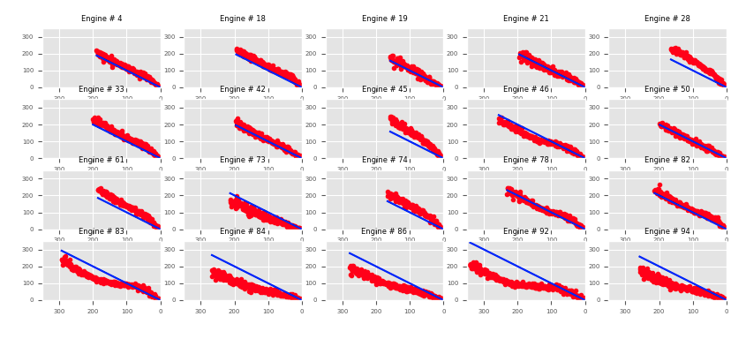
Results Using Test Data

Slide 9
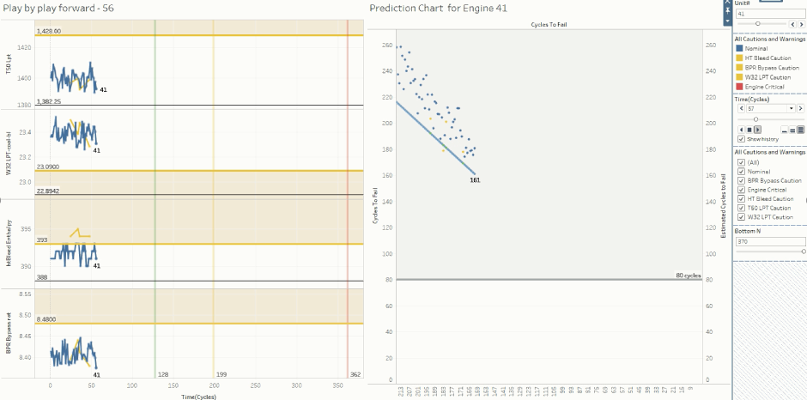

Slide 10
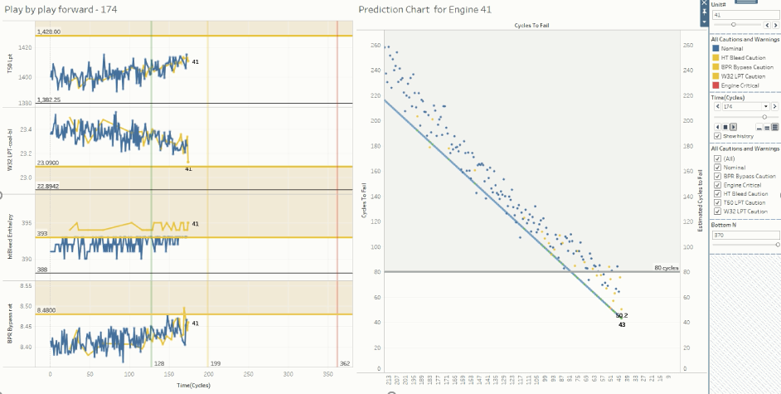

Slide 11
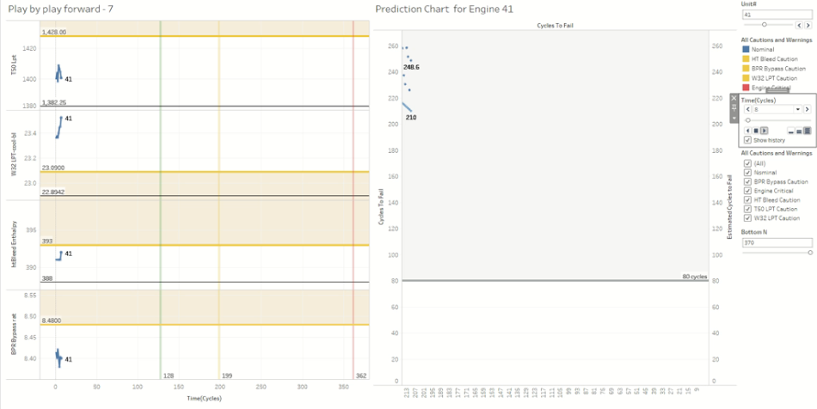

Slide 12
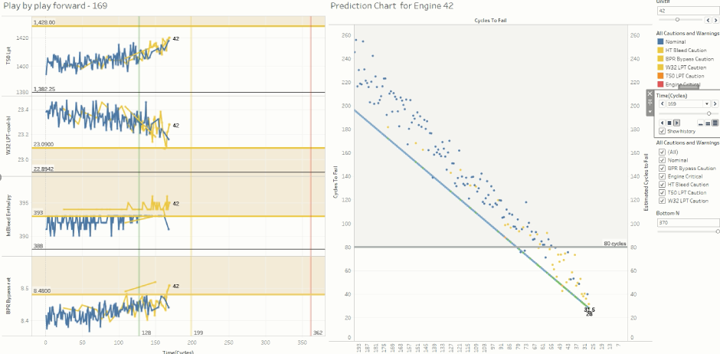

Slide 13
Future Work
Test Model for robusticity
Use on complicated data
Cost estimator vs safety margin calculator
Statistical modeling of failures

Slide 14
Flight Engineer
Aircraft Engine Anomaly and Fault Detection
Steven Fischbach
…your ‘Operational’ Data Scientist

Slide 15
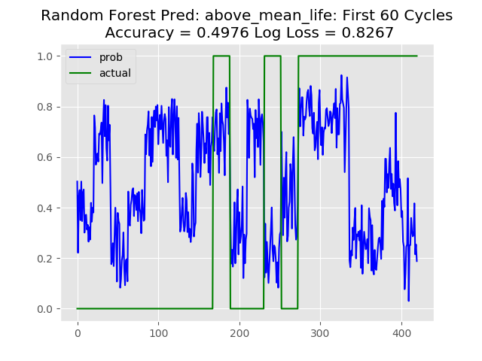
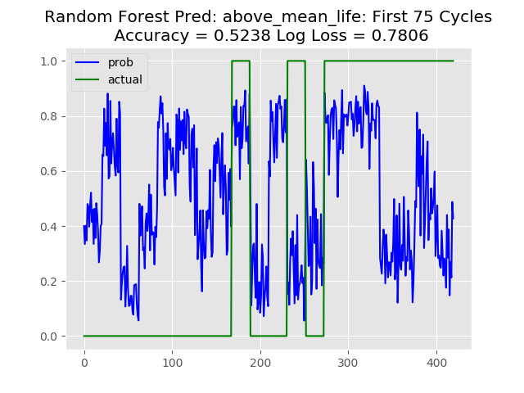
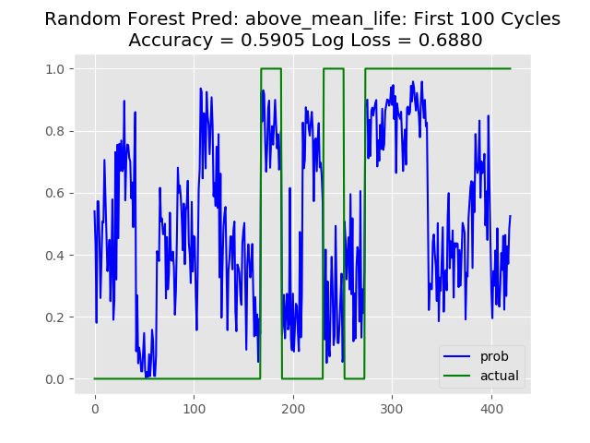
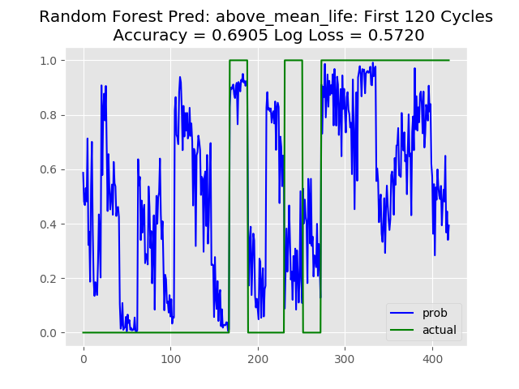
Random forest classifier – Predict Above Mean life (203 Cycles)

Slide 16
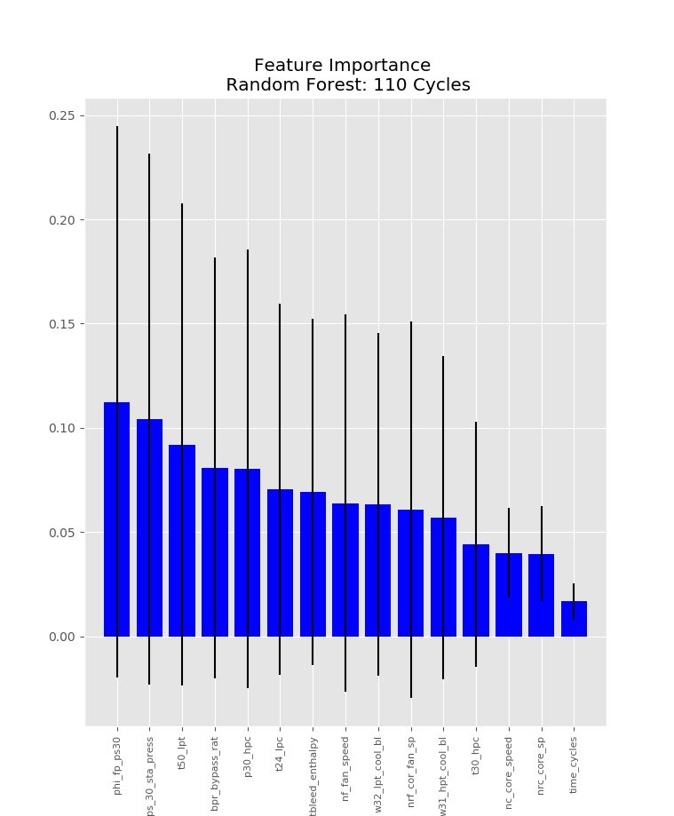
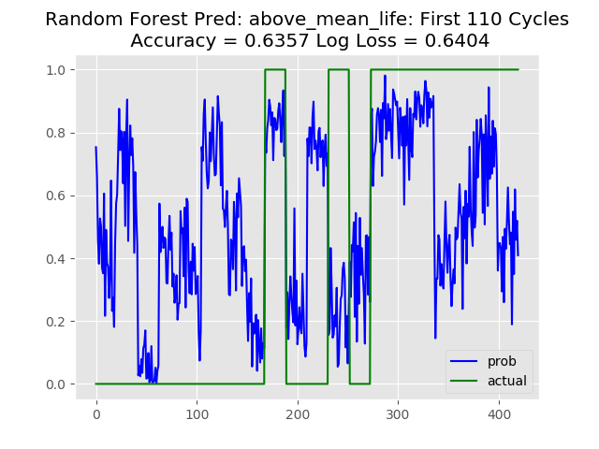
Random forest classifier – Predict Above Mean life (203 Cycles)

Slide 17
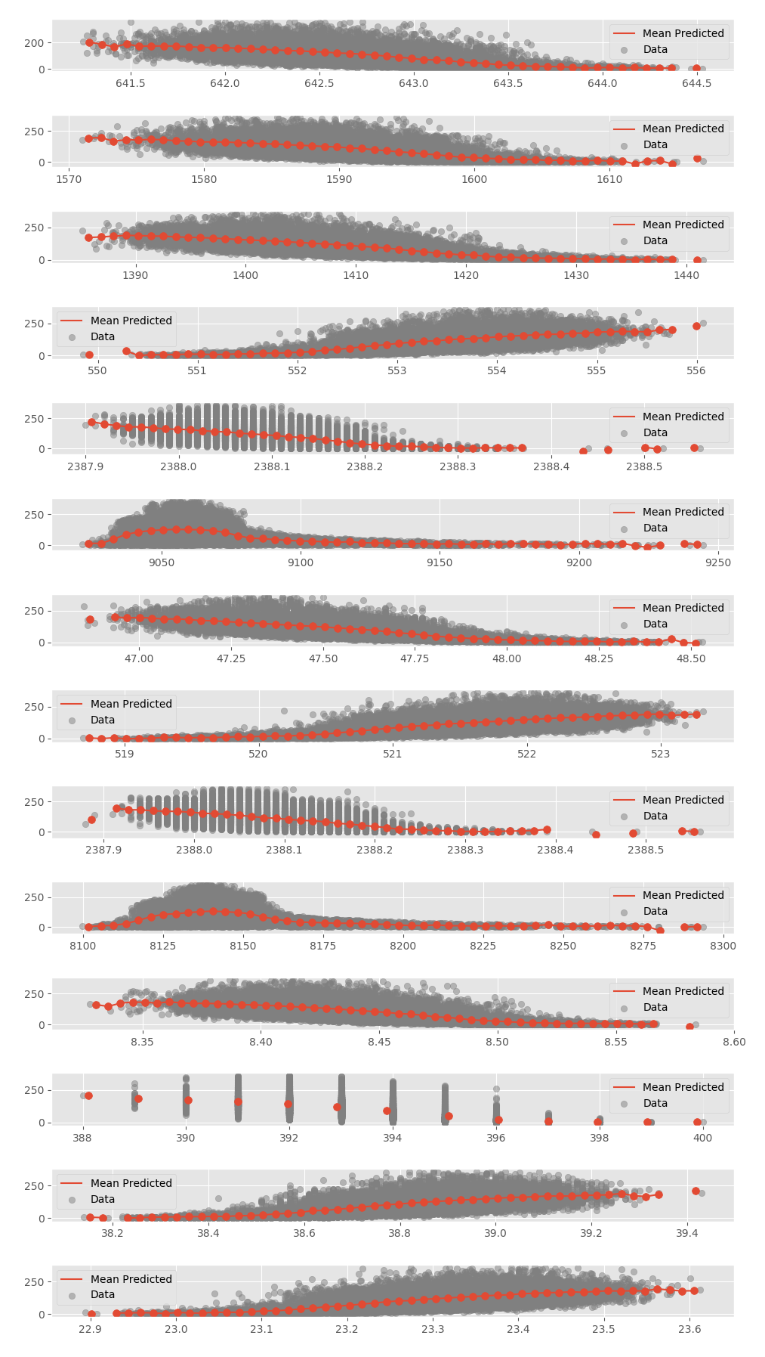

Slide 18
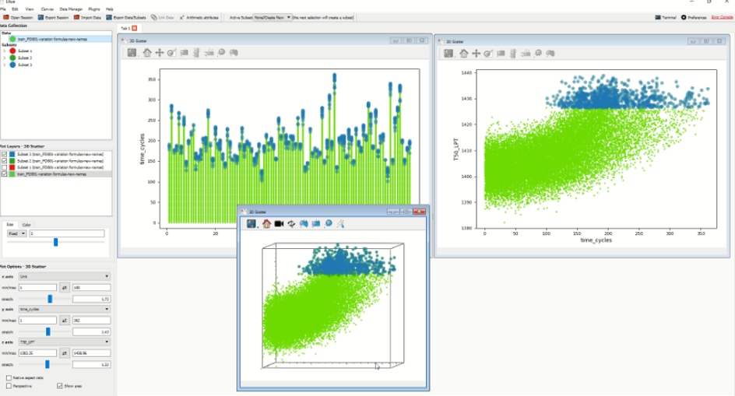

Slide 19
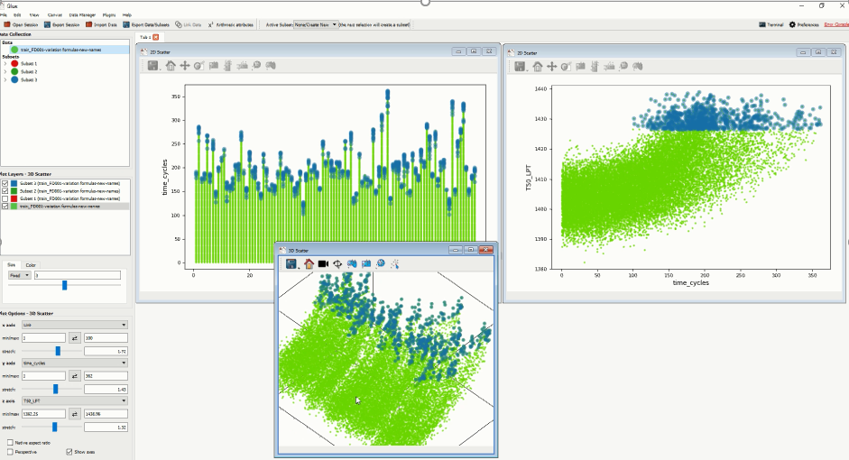

Slide 20
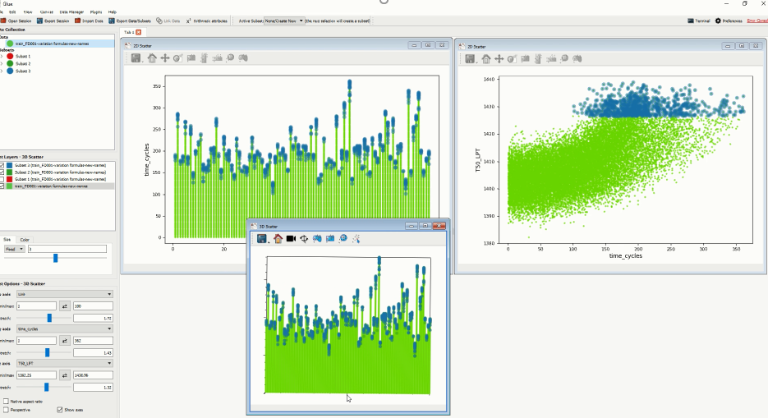

Slide 21
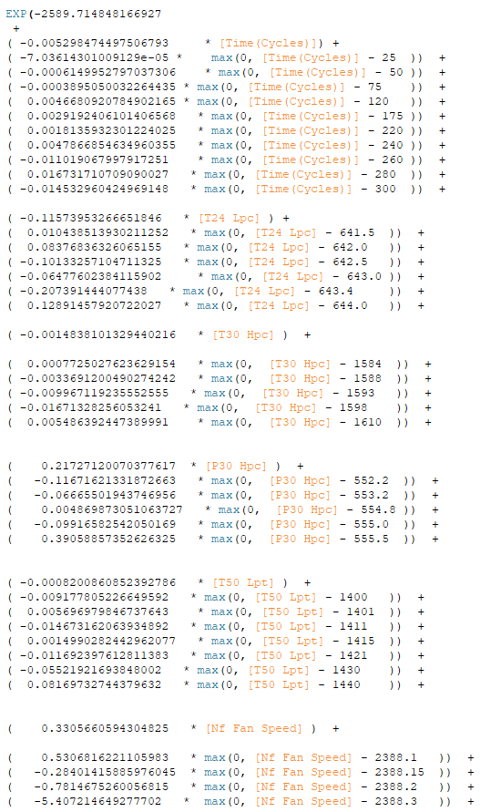
13 features
Predict # of cycles to failure
Read raw data

Slide 22
